Slide 1
Demand Aggregation
https://www.pbssd.gov.in
eGovernance in PBSSD
01-11-2021

Slide 2
TP Application Process by Industries (with available training venue)

Slide 3
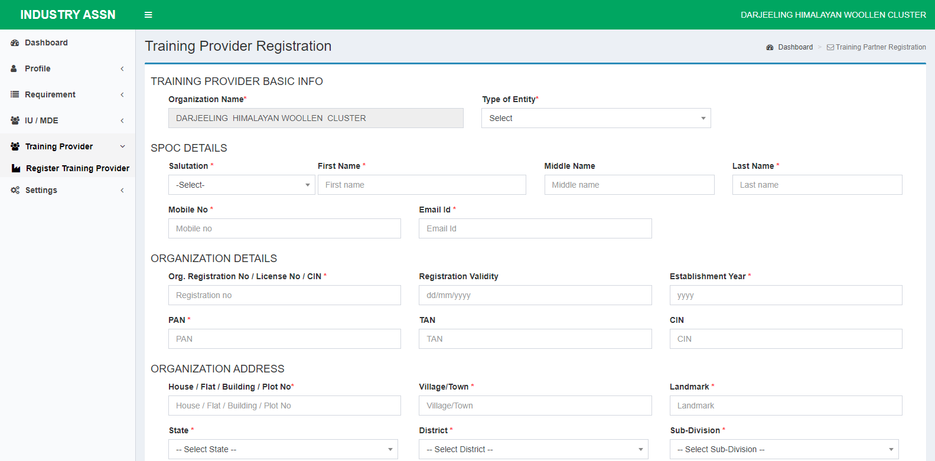
TP Registration Application form to be filled up by respective industries for on-boarding as TP

Slide 4
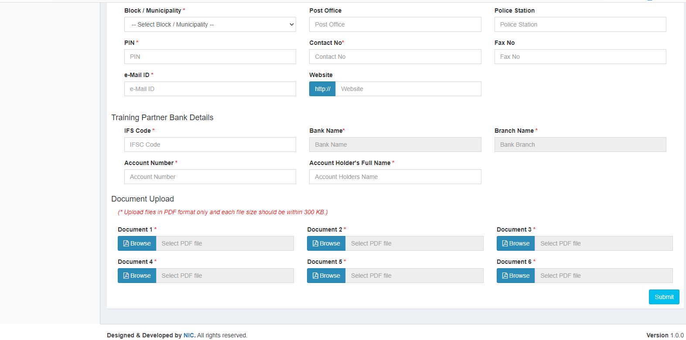
Industry Association needs to fill up bank details and upload other necessary documents.

Slide 5
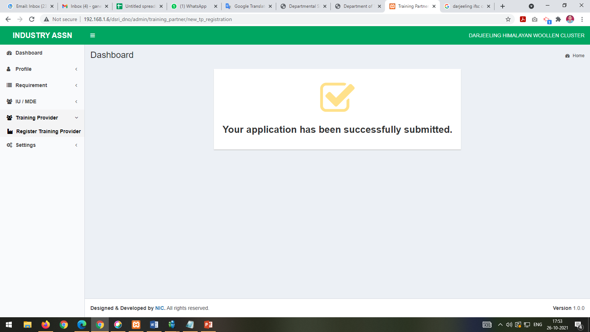
After submitting the TP Application form success message will be shown in the screen.

Slide 6
TP Application Verification Process by DPMU PBSSD

Slide 7
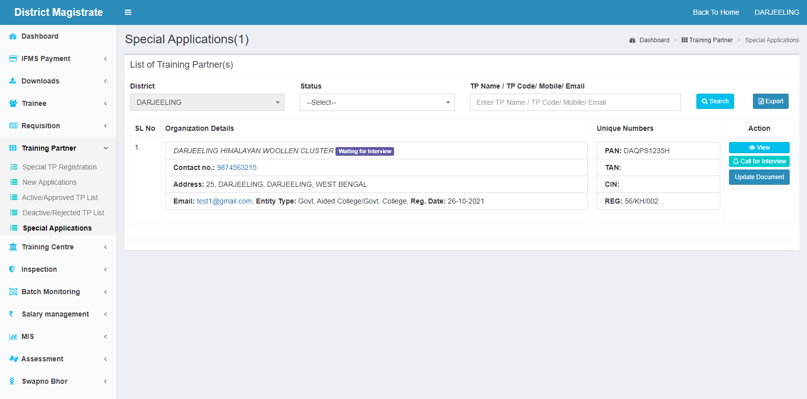
TP Application will be shown under Special Application in District Magistrate dashboard.

Slide 8
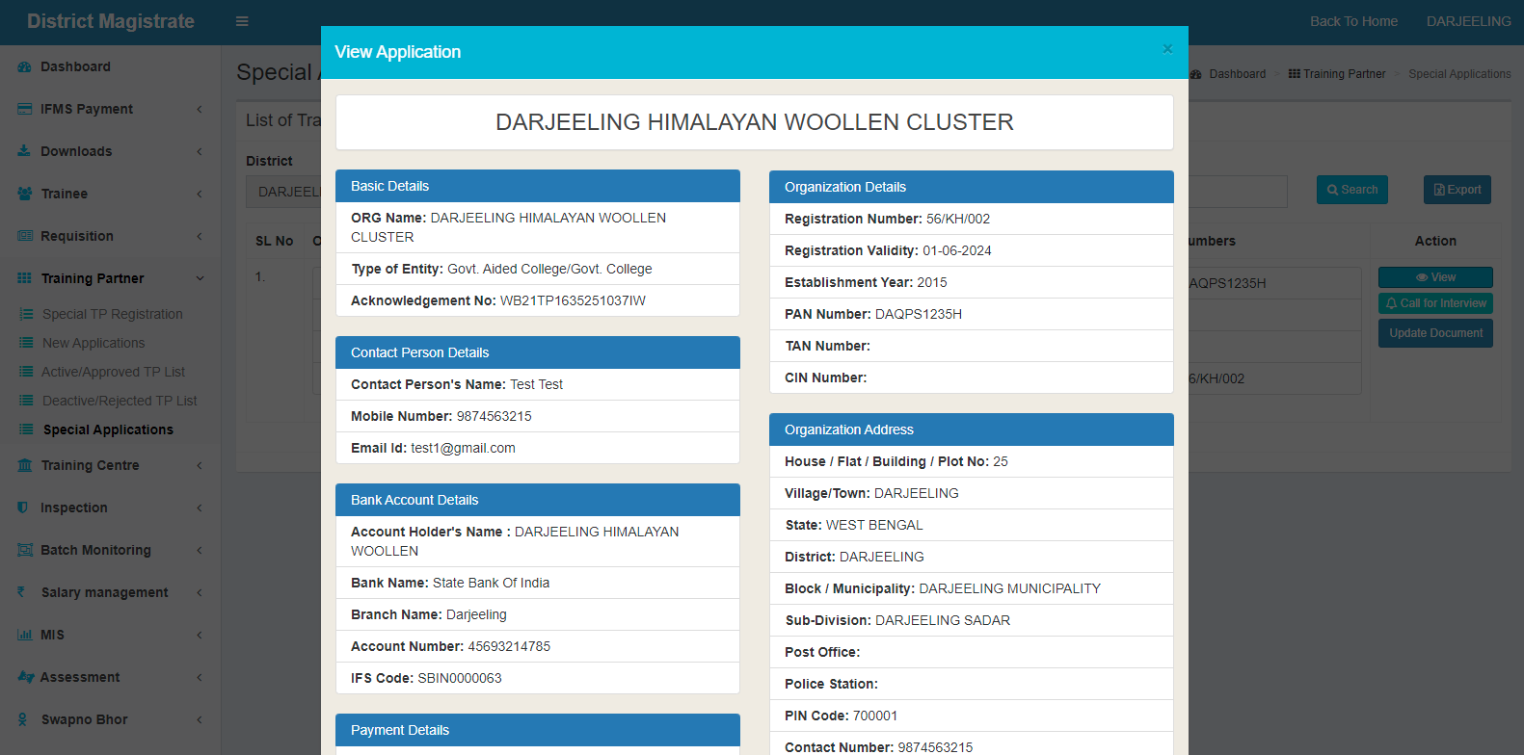
District Magistrate can view the TP application details by clicking on “View” button.

Slide 9
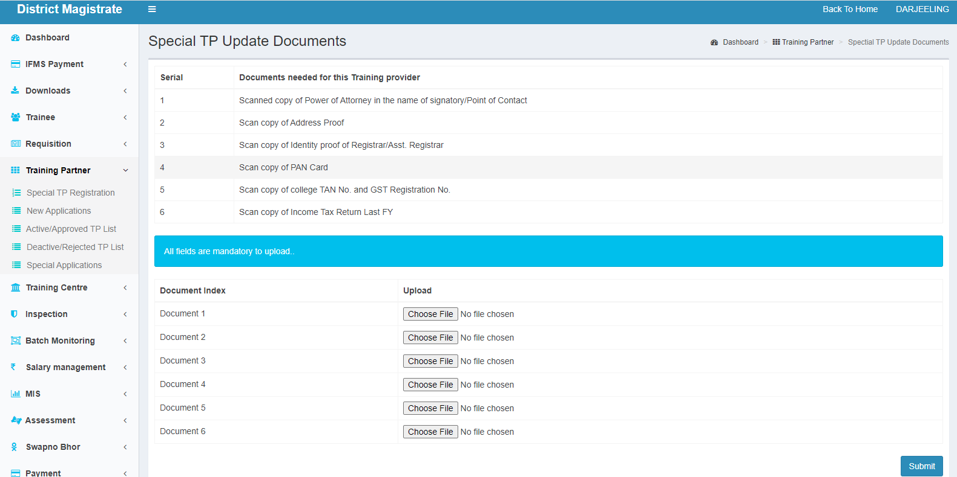
District Magistrate can update the TP Application document (if required) by click on “Update Document” under the Training Partner Main Menu.
Special TP Update Documents

Slide 10
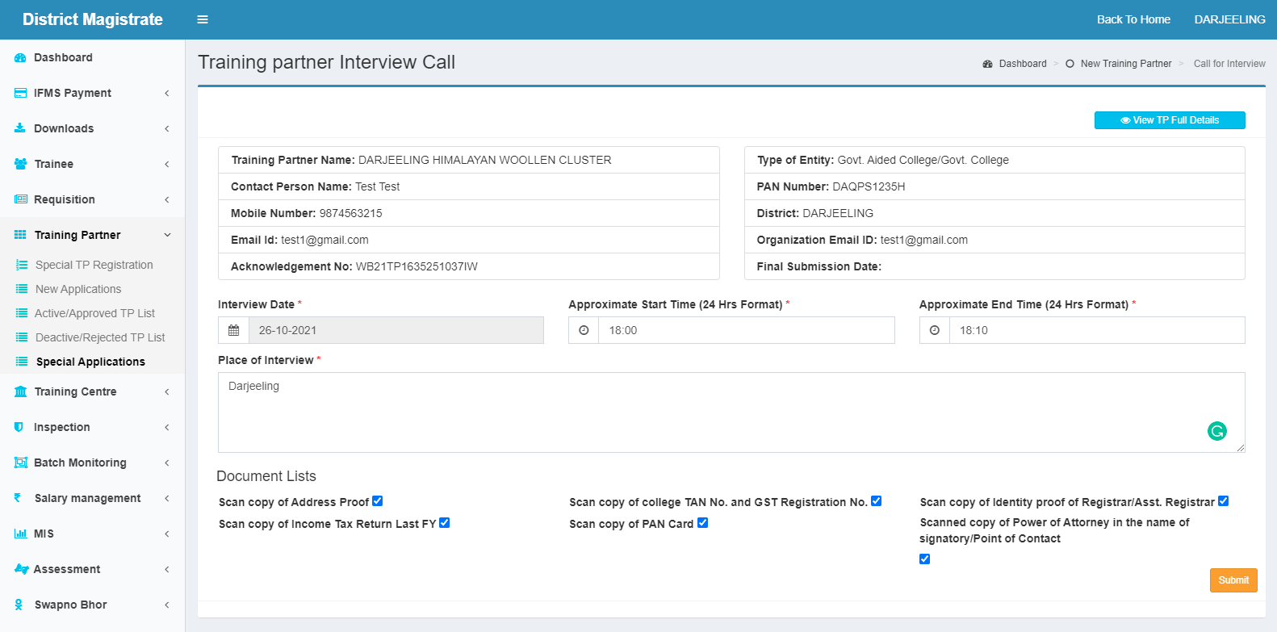
District Magistrate can schedule the TP interview by clicking on “Call for Interview” button and fill up the details in the form.

Slide 11
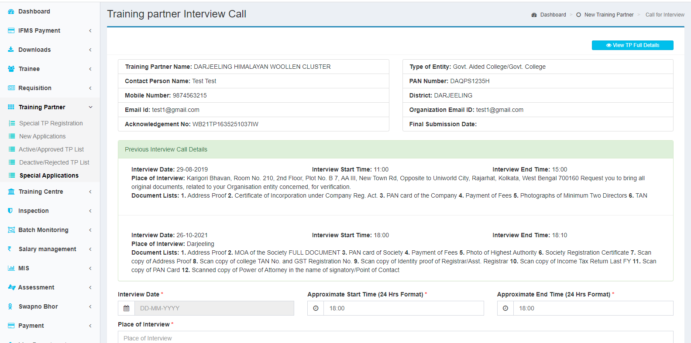
District Magistrate can re-schedule the TP interview maximum up to 3 times by clicking on “Call for Interview” button if some one missed the interview date and time.

Slide 12
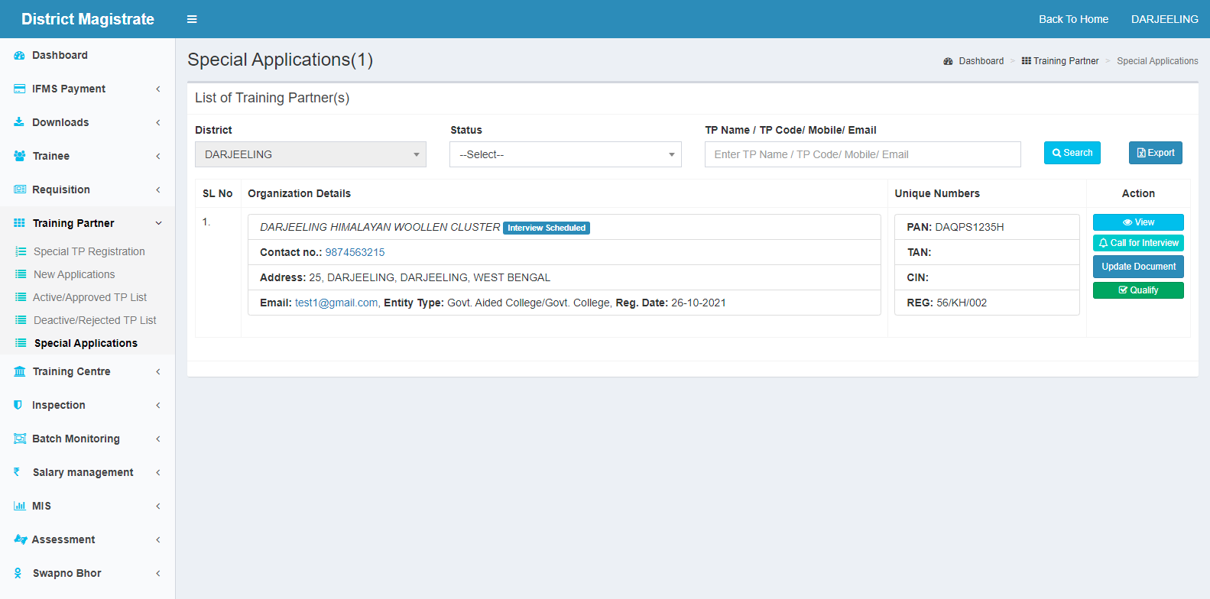
Once the interview is completed then Qualify button will be visible at Special Application under Training Provider main menu.

Slide 13
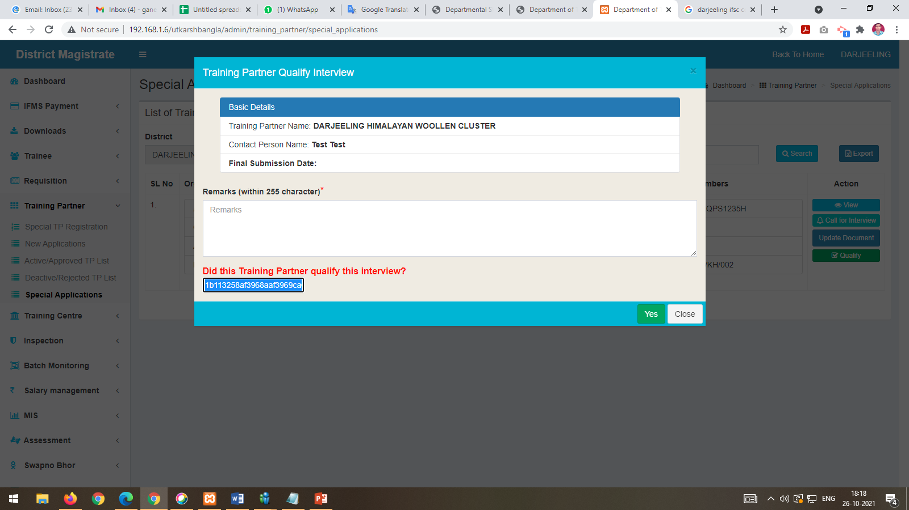
If TP qualifies for the interview click on the “Yes” button for confirmation providing the Remarks.

Slide 14
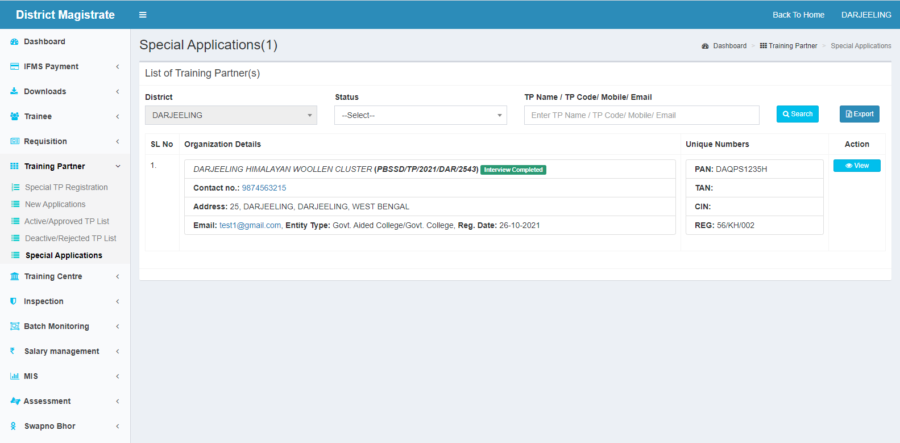
Once TP qualifies for the interview, TP application will be forwarded to District Vice Chairman.

Slide 15
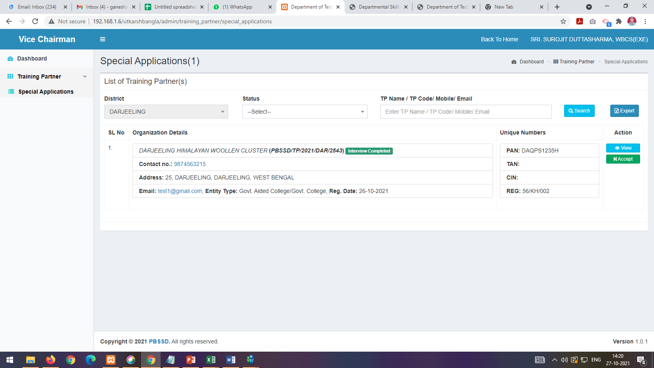
TP application will be accepted from Vice Chairman dashboard.

Slide 16
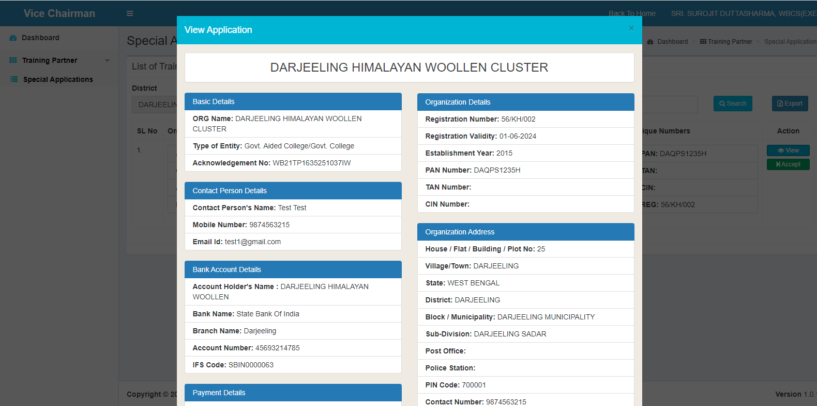
Vice Chairman can view the TP application details by clicking on “View” button.

Slide 17
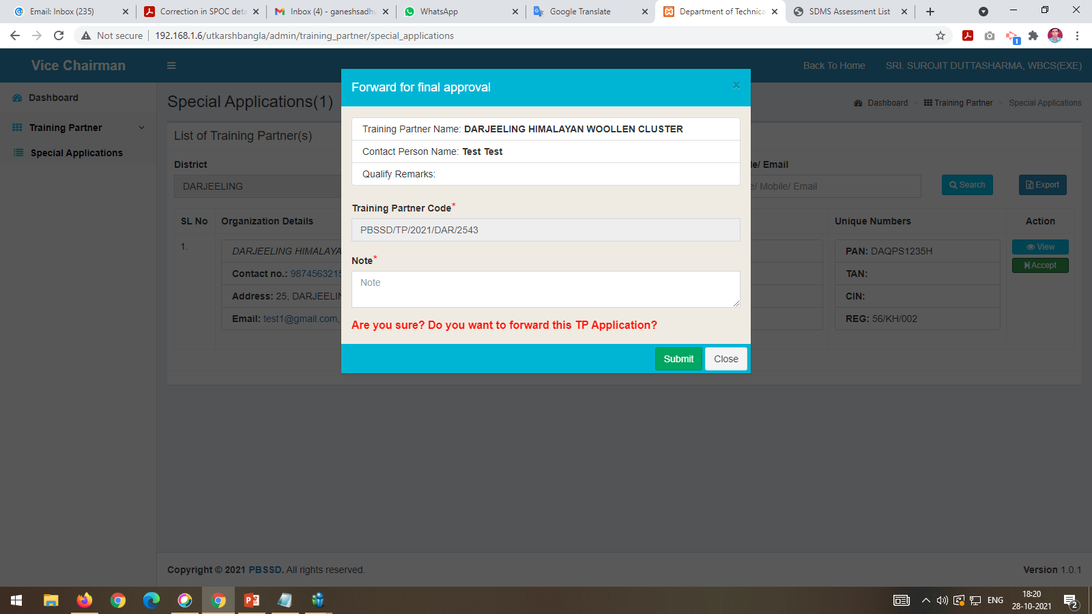
Vice Chairman need to accept the TP Application for final approval

Slide 18
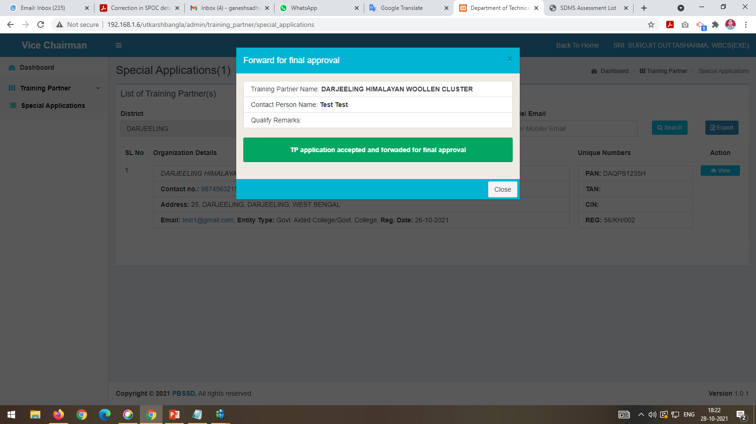
Once accepted, TP Successfully accepted and forwarded for final approval message will be shown.

Slide 19
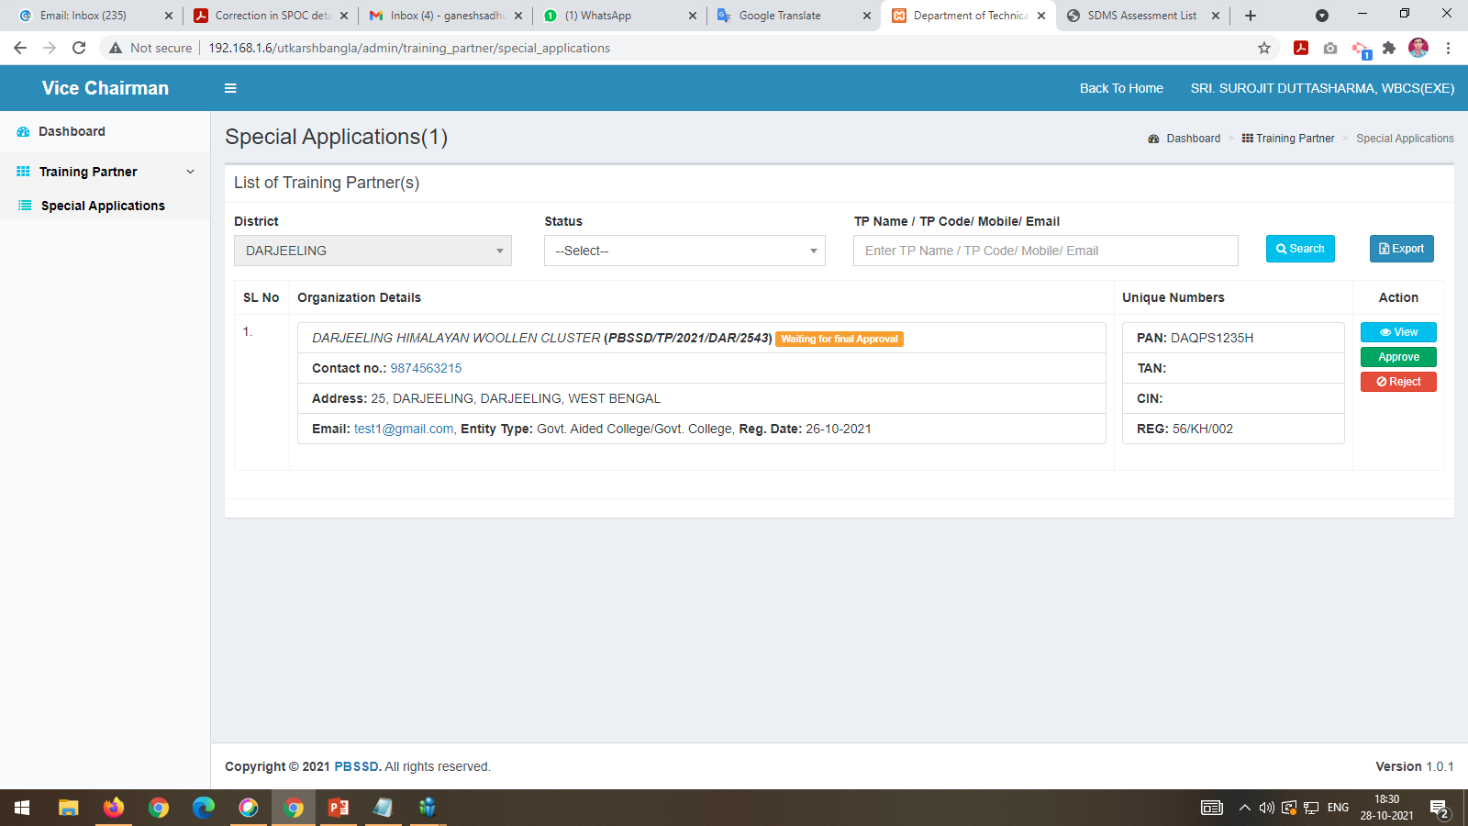
Finally Vice Chairman can approve the TP Application by clicking on “Approved” button

Slide 20
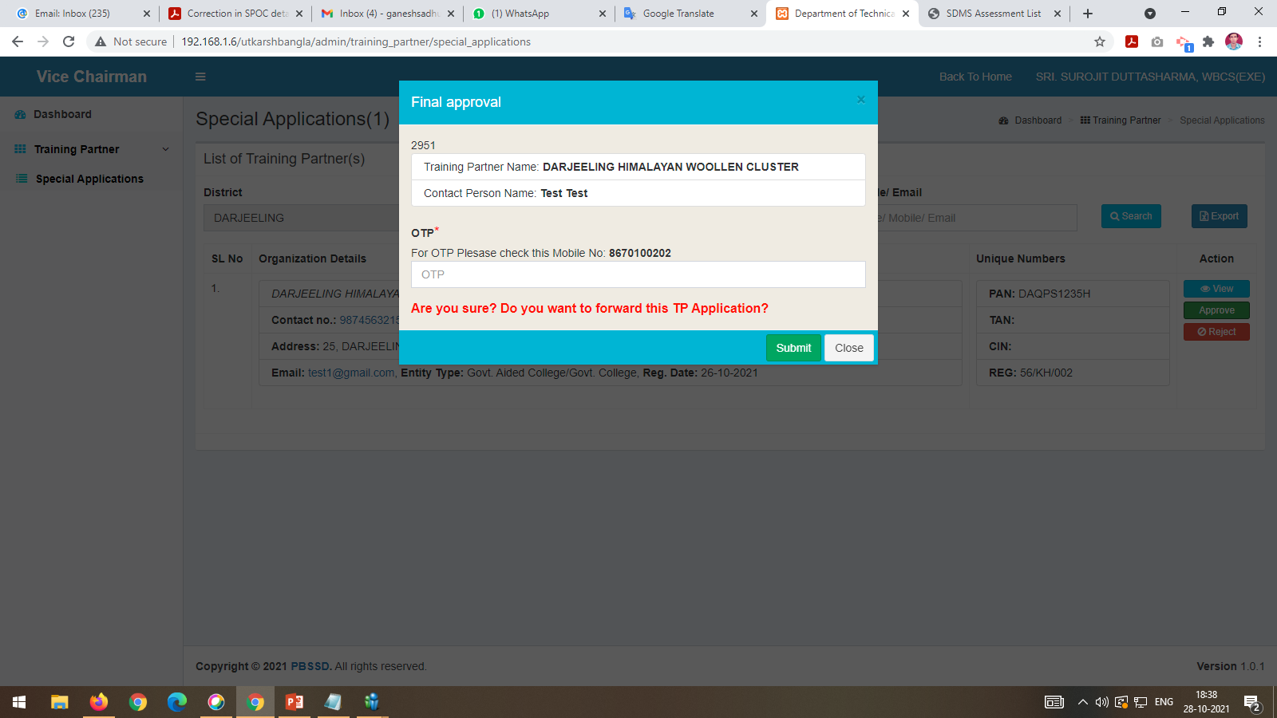
Vice Chairman will put the OTP before clicking on the “Submit” button.

Slide 21
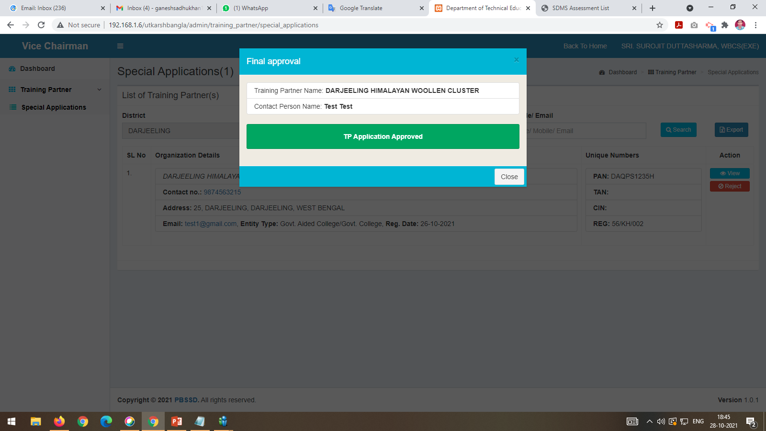
TP Approved success message will be shown

Slide 22
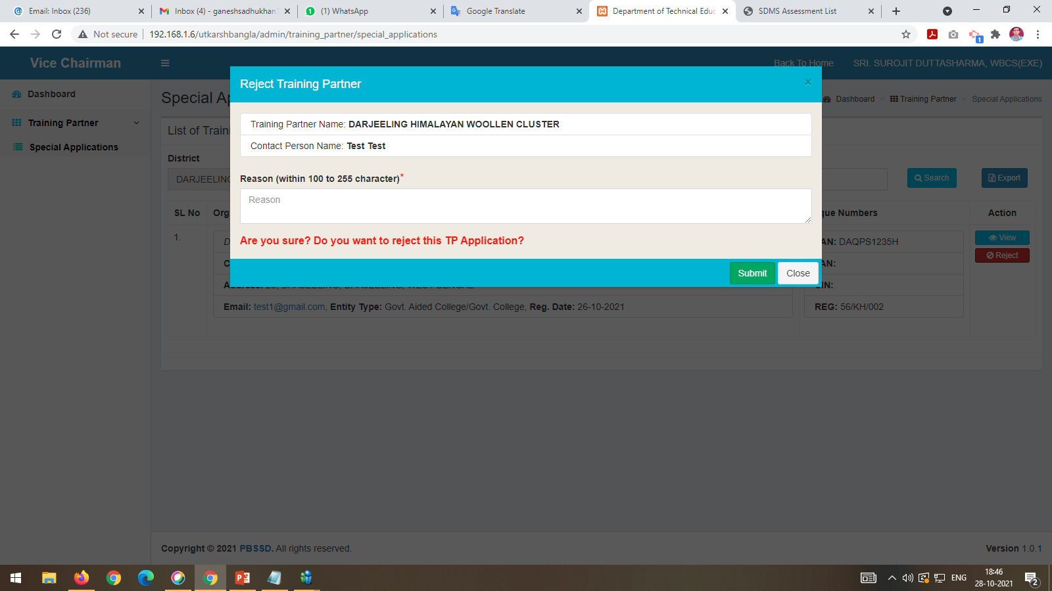
Vice Chairman can reject the TP application by clicking on the “Reject” button after given the reject reason.

Slide 23
THANK YOU For any Technical Assistance please mail us to – support.tetsd-wb@gov.in

