Slide 1
Demand Aggregation
https://www.pbssd.gov.in
eGovernance in PBSSD
01-11-2021

Slide 2
TC Application Process by Industries (with available training venue)

Slide 3
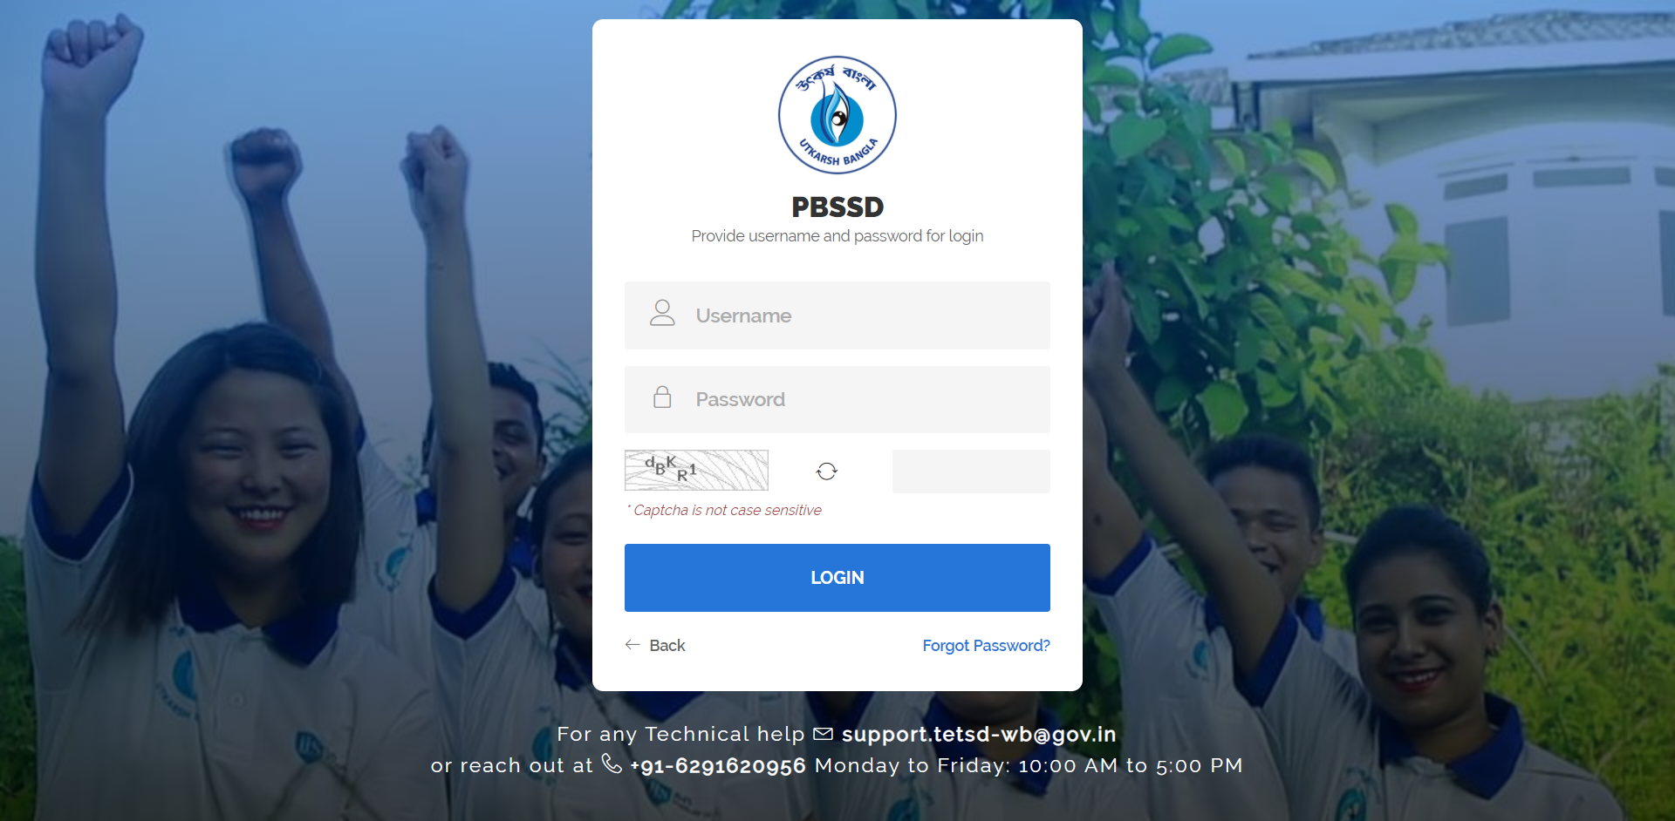
Login page for Departmental Skilling Requirement for Industries Module for TP & TC Onboarding URL : https://www.pbssd.gov.in/admin/

Slide 4
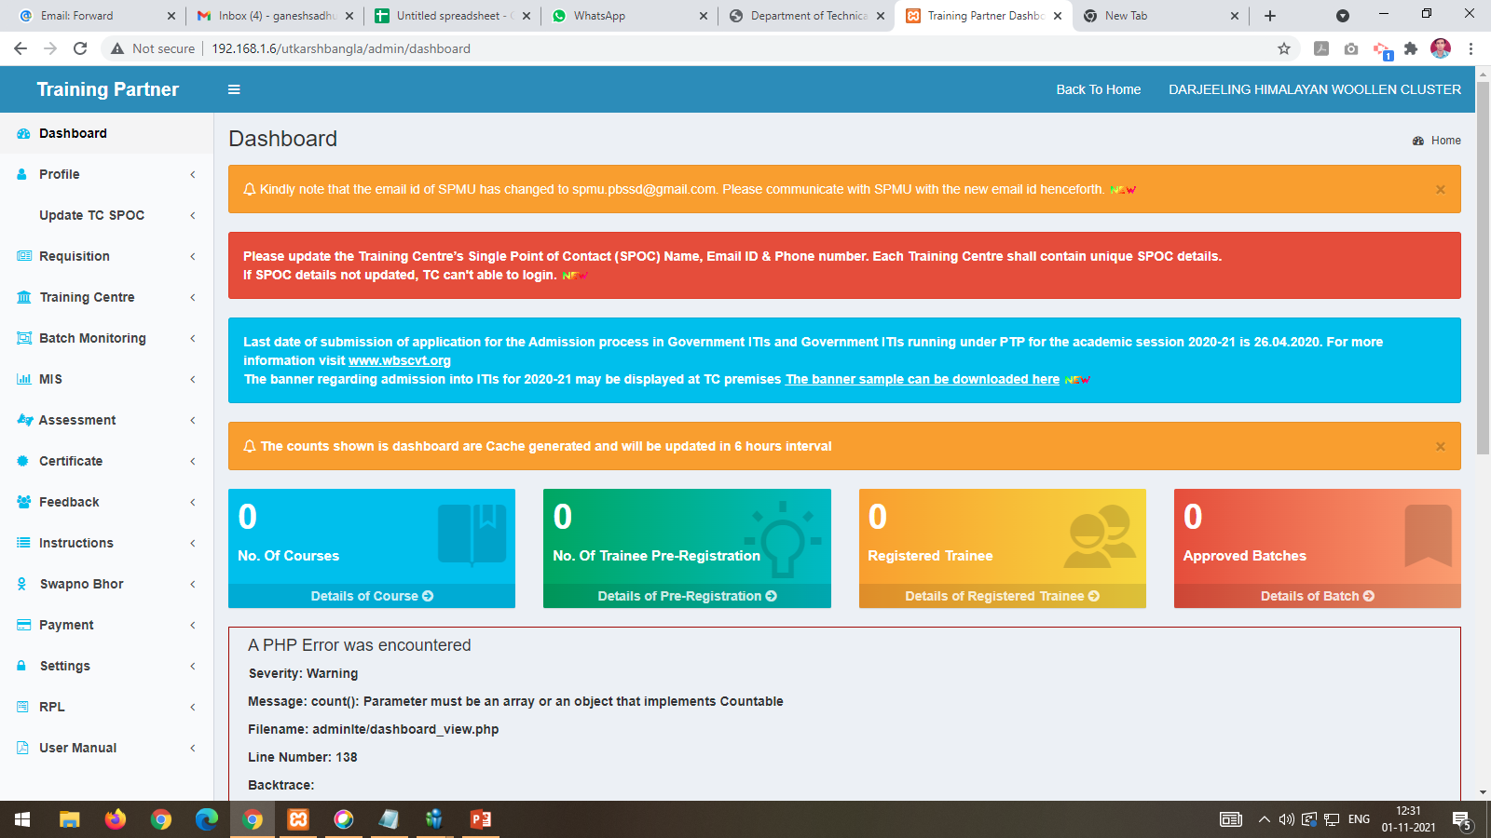
After login into the system with user id and password.

Slide 5
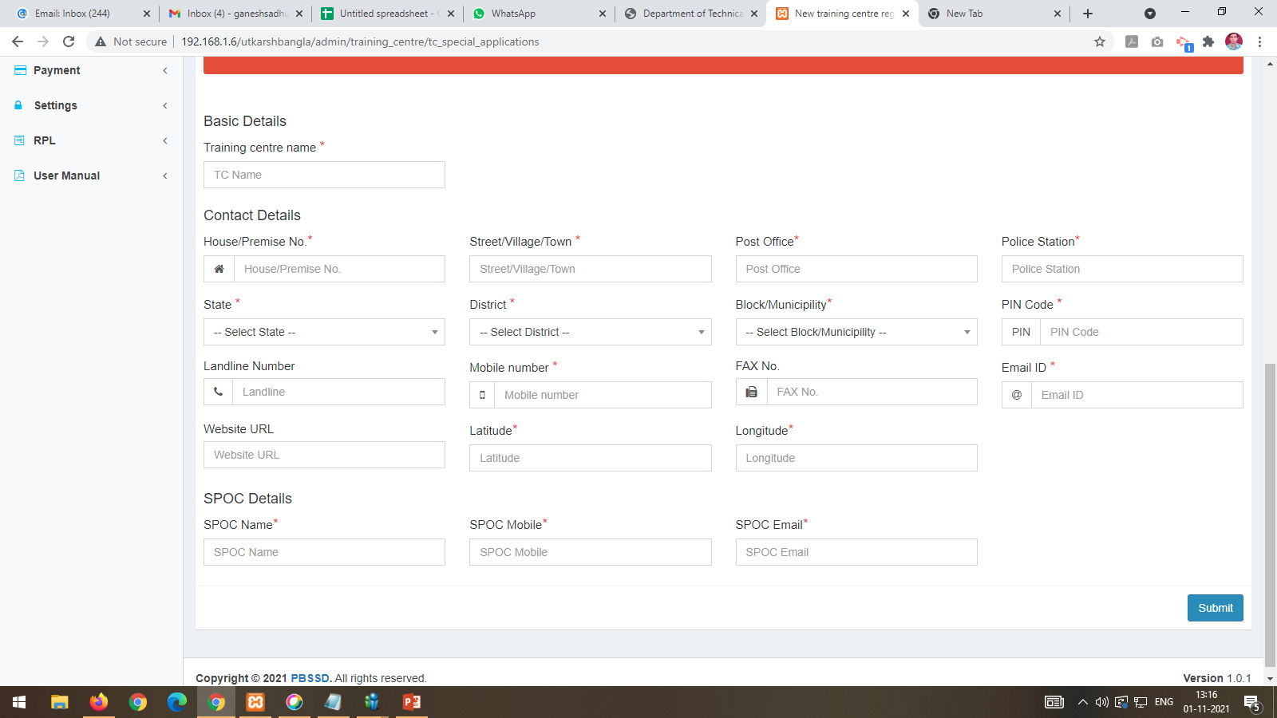
Click on Special Application under Training Centre main menu a TC creation form will be appear.

Slide 6
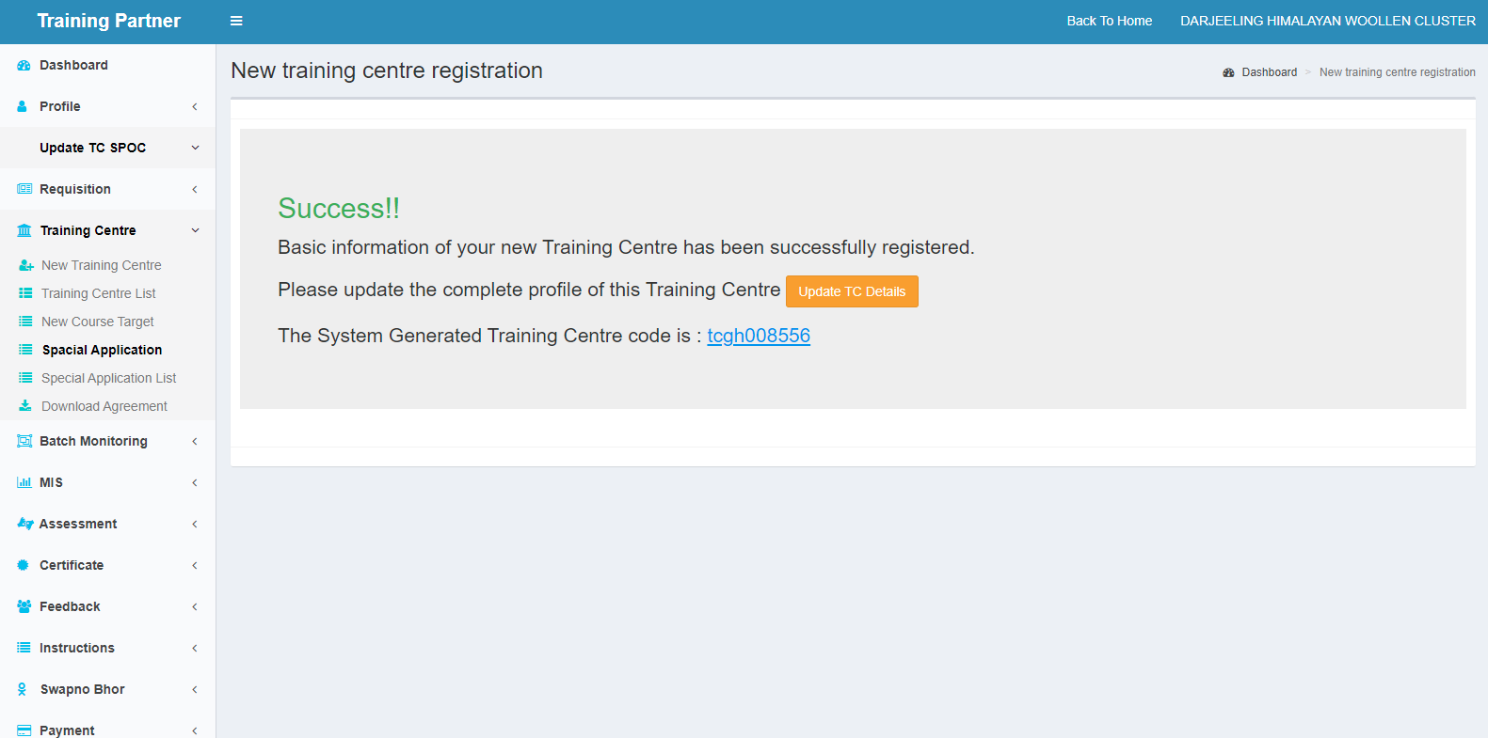
After filling up the basic details of the TC application form a system generated TC code will be shown with success message with update TC details button for filling up the other details of the TC.

Slide 7
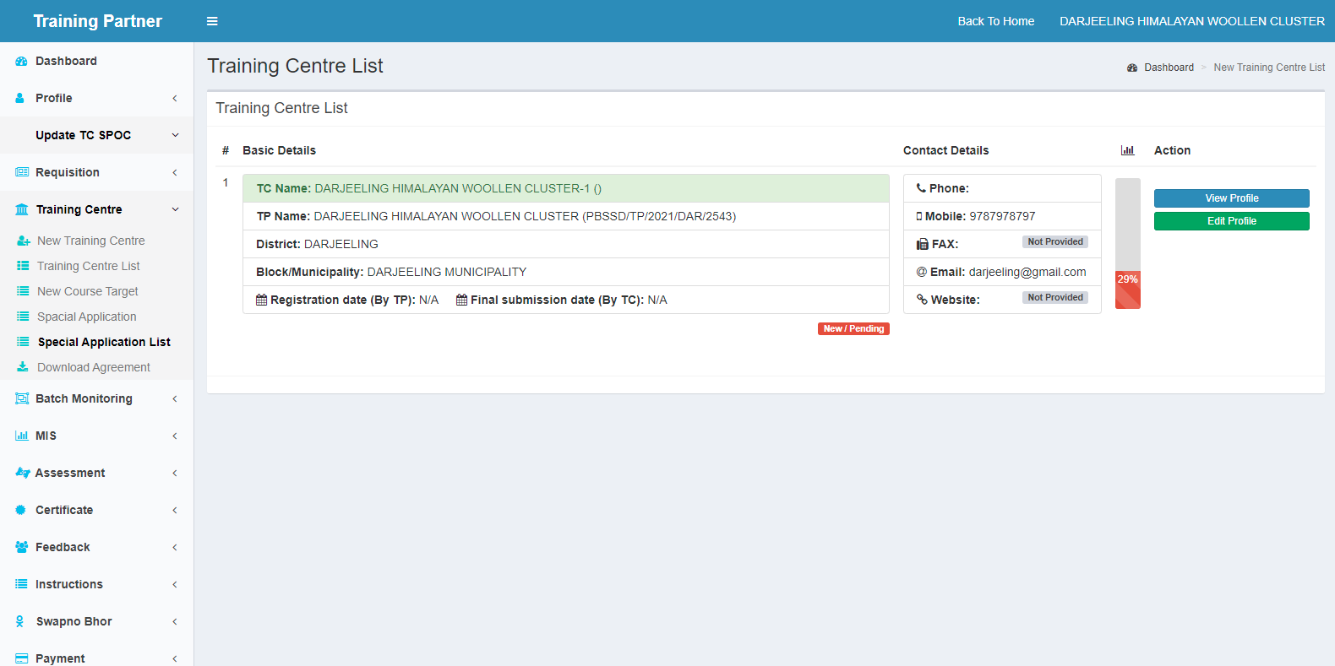
Edit Profile button is visible at Special Application List from where further TC application can be edited

Slide 8
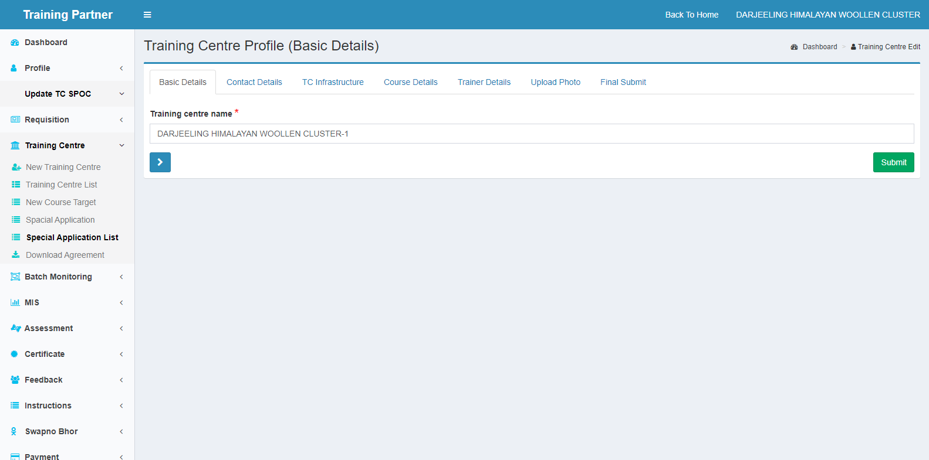
By clicking on Edit button TC name will be shown under the Basic Details tab.

Slide 9
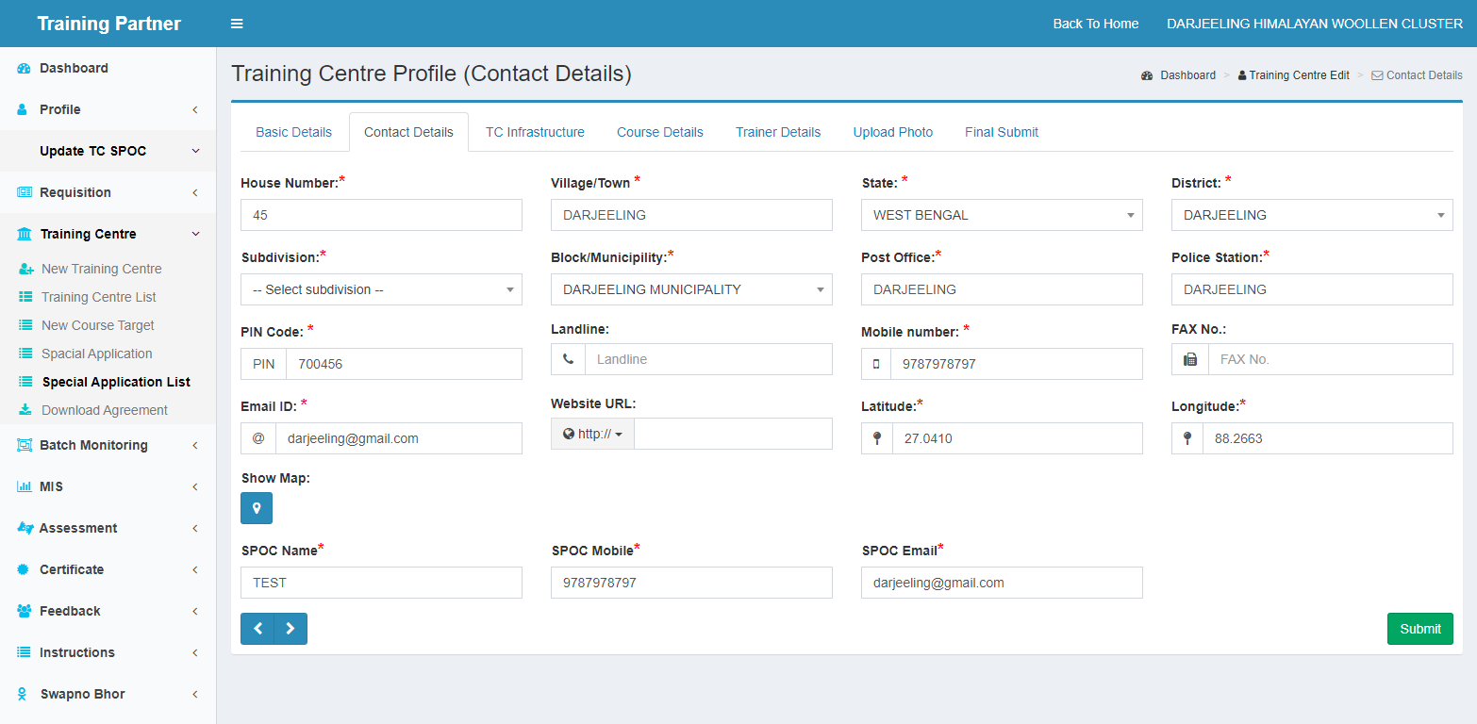
By clicking on Contact Details tab following details needs to be filled up.

Slide 10
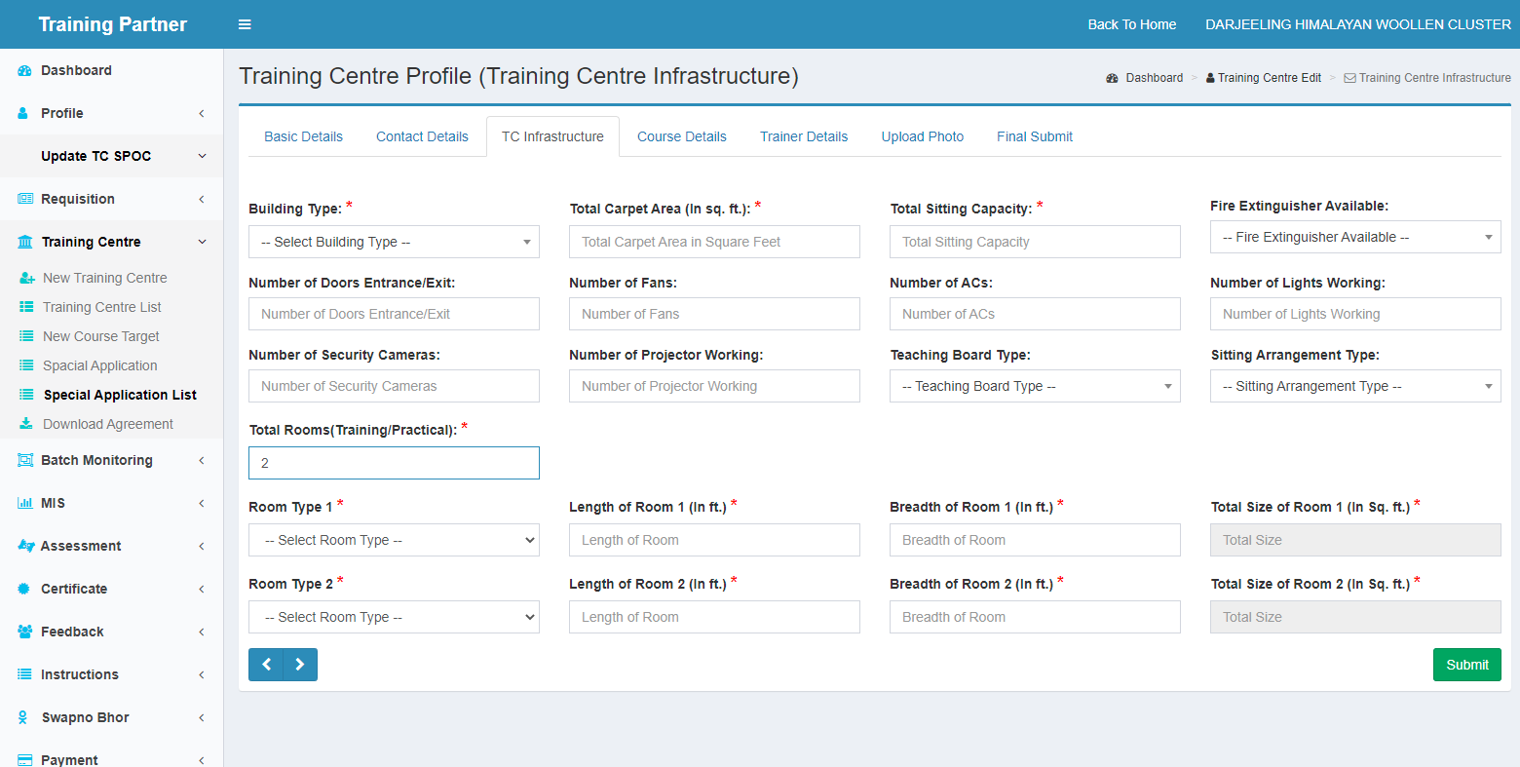
By clicking on TC Infrastructure tab following details needs to be filled up.

Slide 11
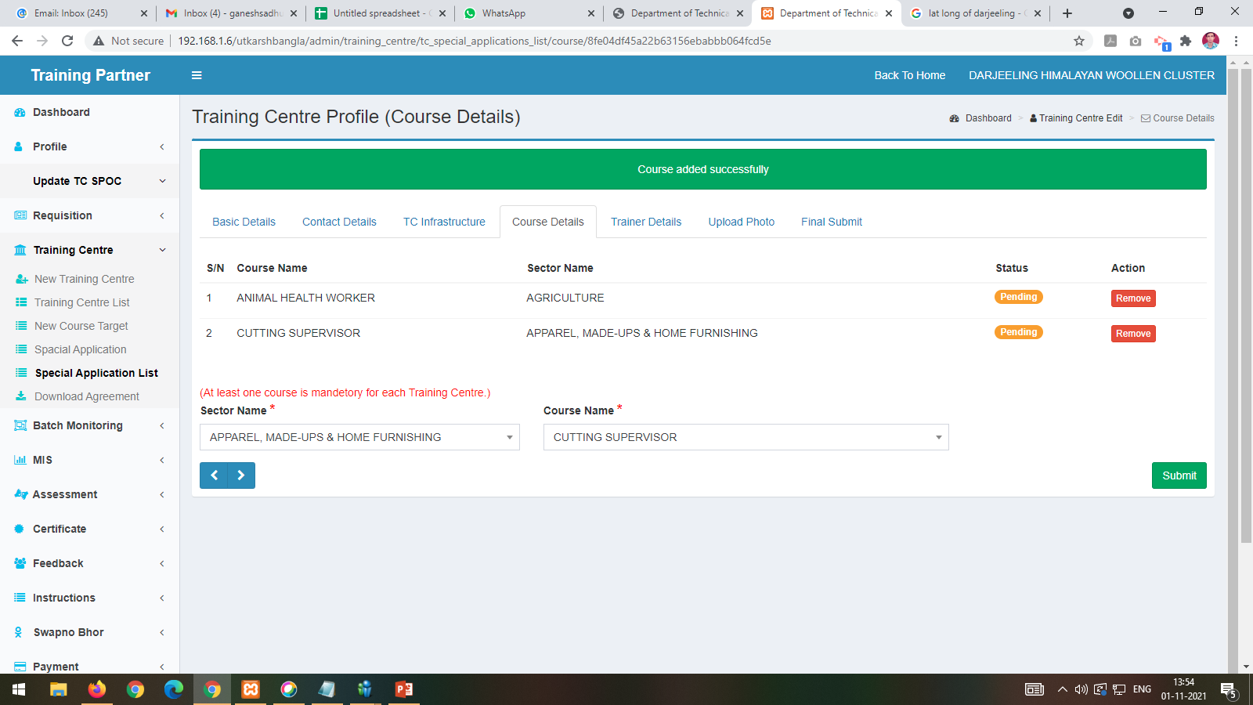
By clicking on Course Details tab Multiple Courses can be added of a particular TC by choosing the Sector and course from the dropdown

Slide 12
Remove functionality has been provided for wrong entry.

Slide 13
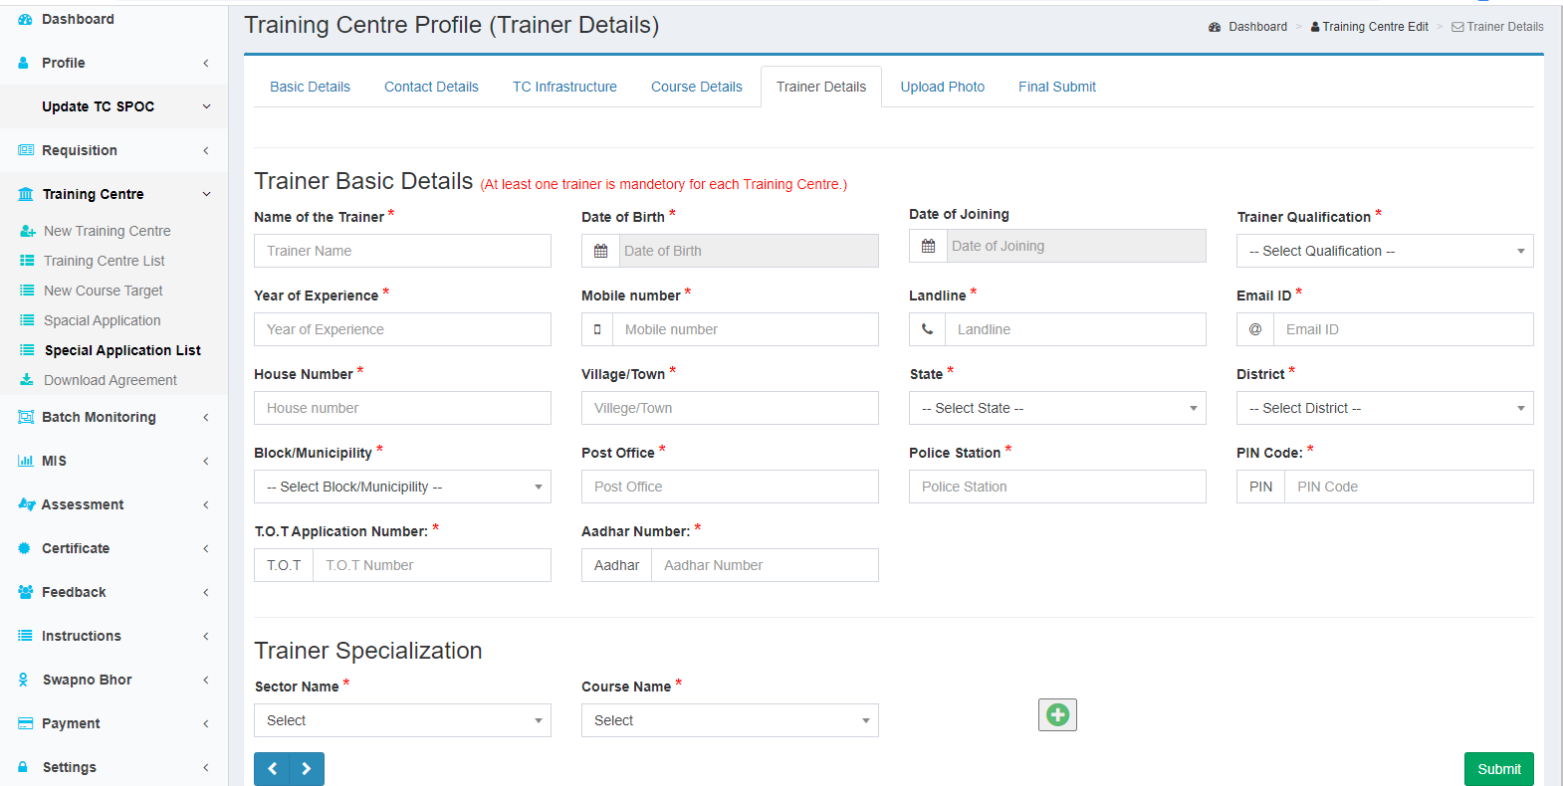
Trainer Details needs to be filled up with trainer Specialization

Slide 14
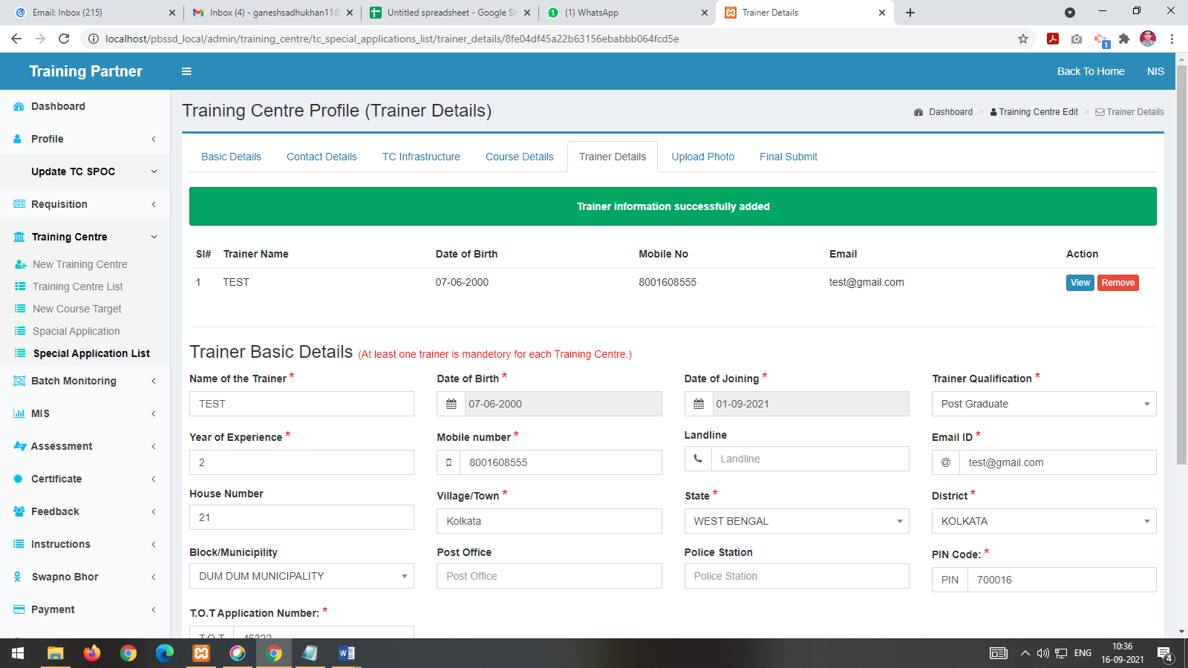
Trainer Details filled up with trainer Specialization can be viewed and removed if required

Slide 15
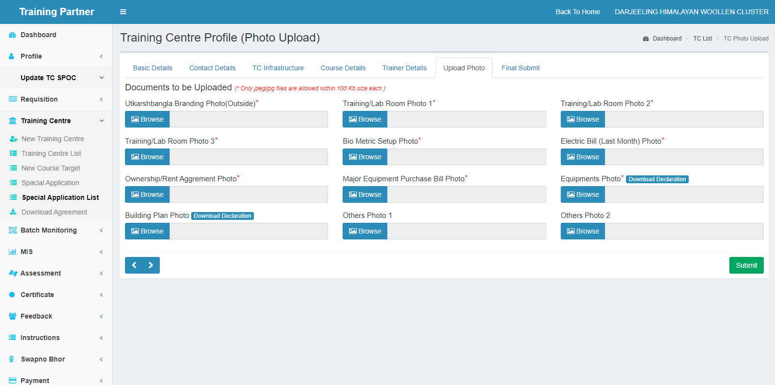
Different Images needs to be uploaded for completing the TC Application

Slide 16
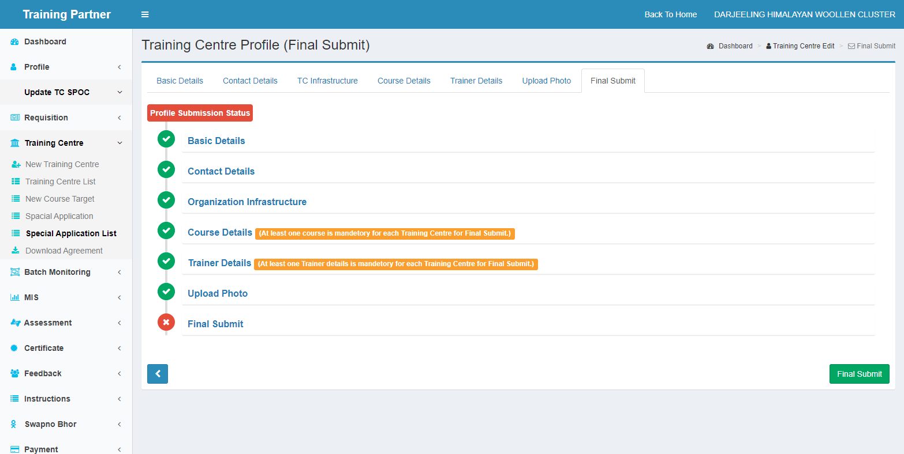
Final Submission page for TC Application from TP Login with profile status

Slide 17
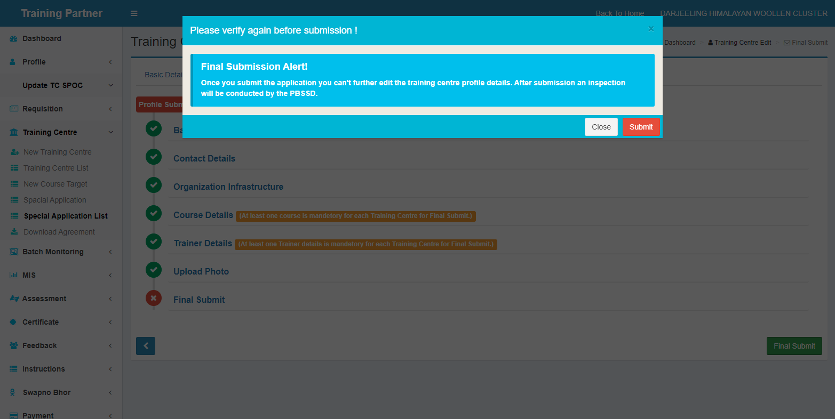
One confirmation pop-up will be open for TC profile submission

Slide 18
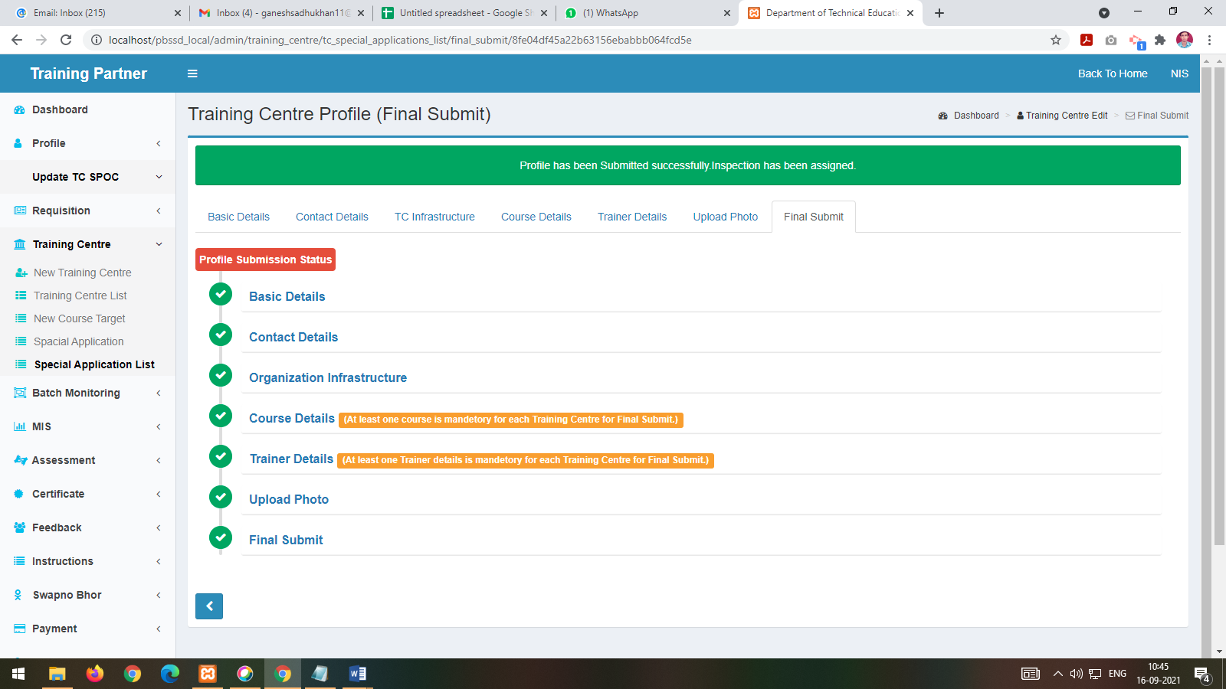
Profile Finally submitted with Status details of each stage

Slide 19
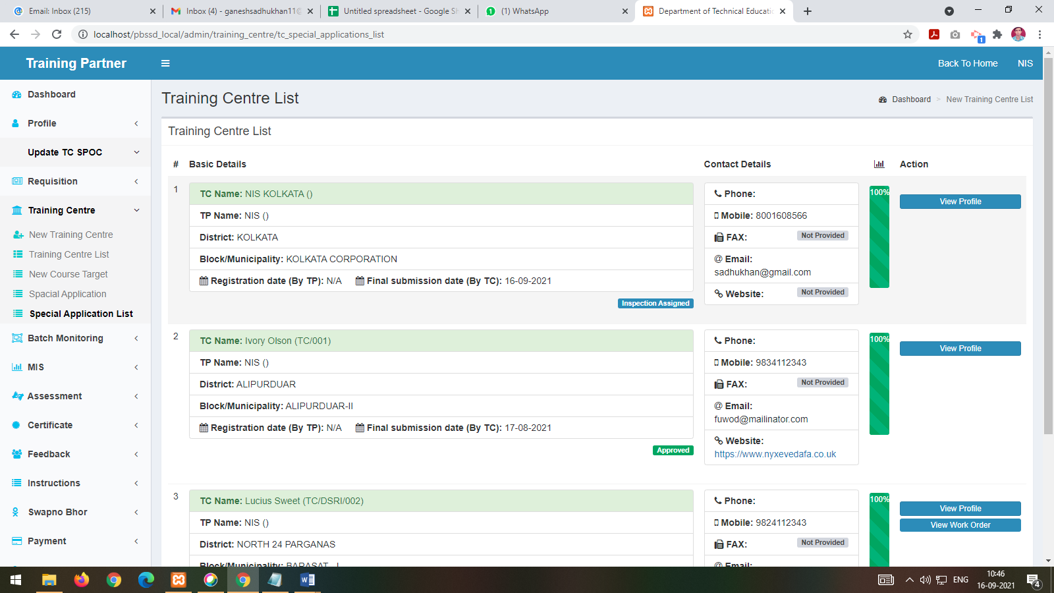
After final submission the TC application is under inspection and details application can be viewed by clicking View Profile button

Slide 20
THANK YOU For any Technical Assistance please mail us to – support.tetsd-wb@gov.in

