Slide 1
Industry Registration
Paschim Banga Society for Skill Development

Slide 2
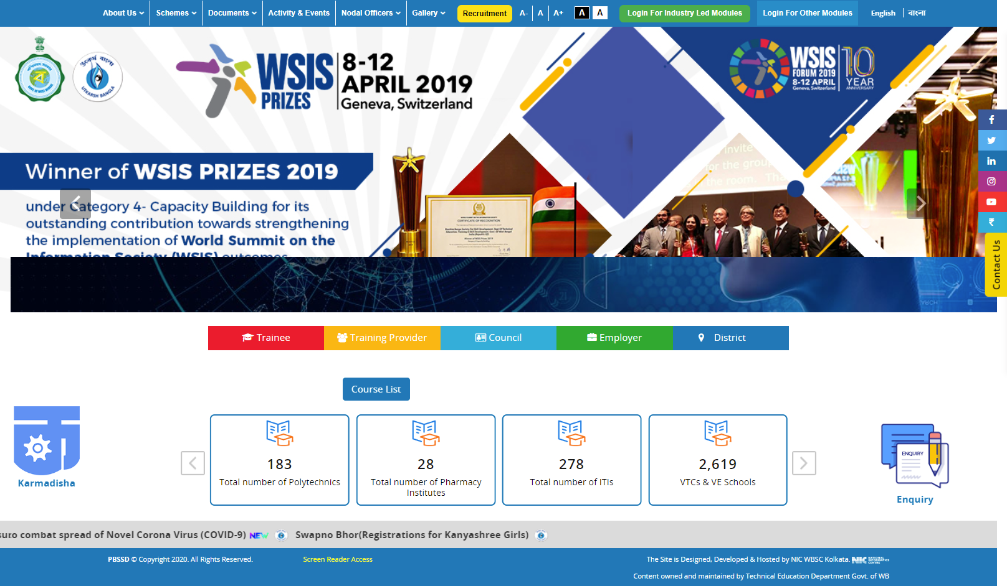
Please enter the URL https://www.pbssd.gov.in/ in any web browser.

Slide 3
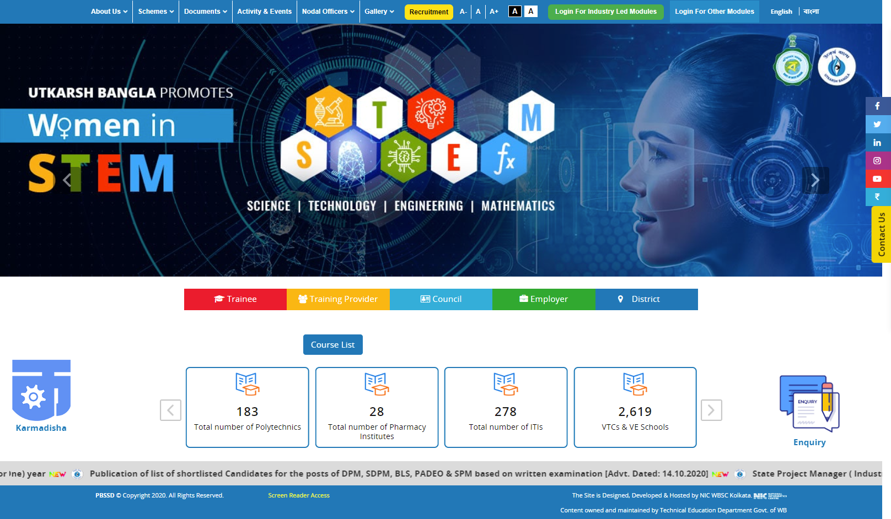
Click on “Login for Industry Led Module”.

Slide 4
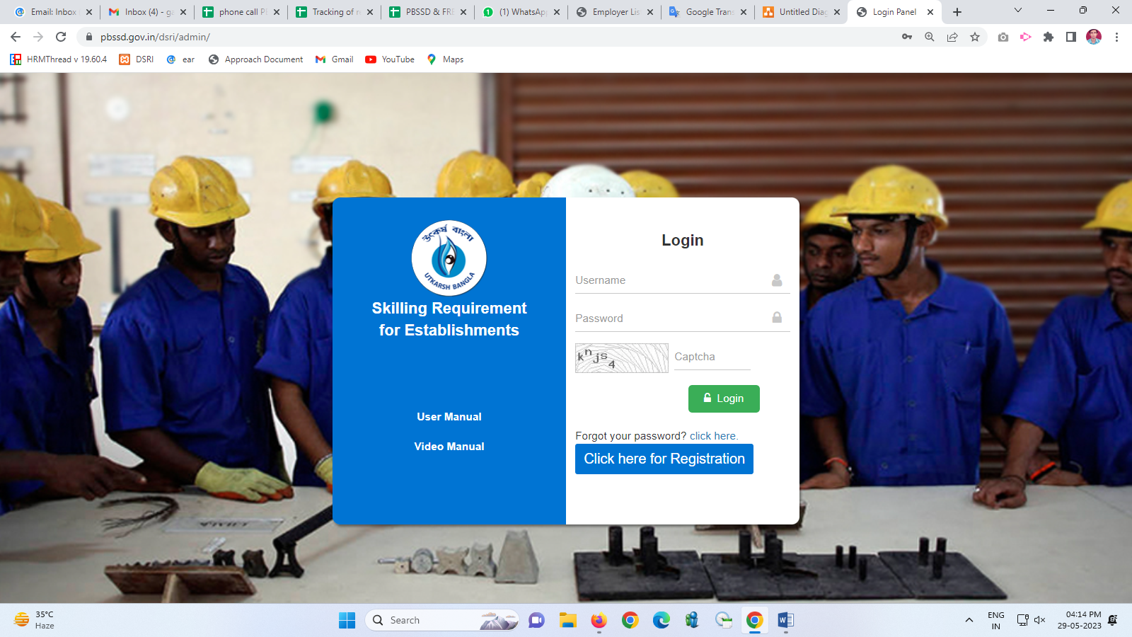
Click on “Click here for Registration” button.

Slide 5
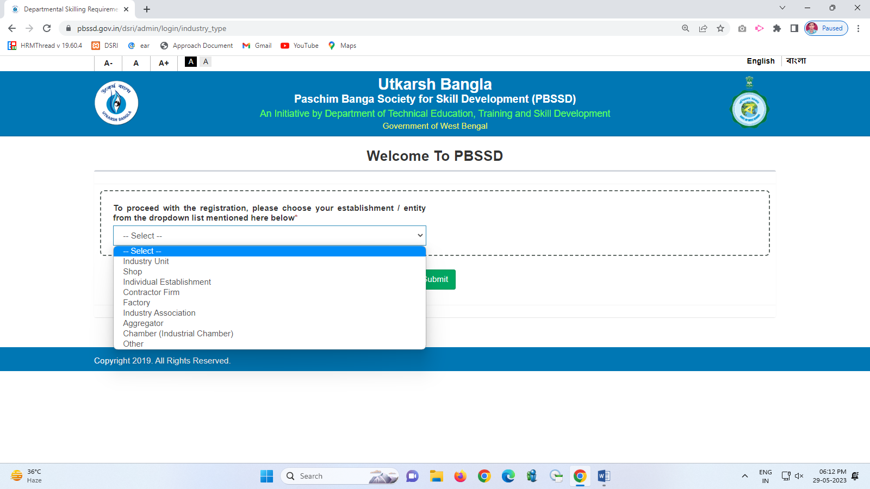
Please select the entity from drop-down list.

Slide 6
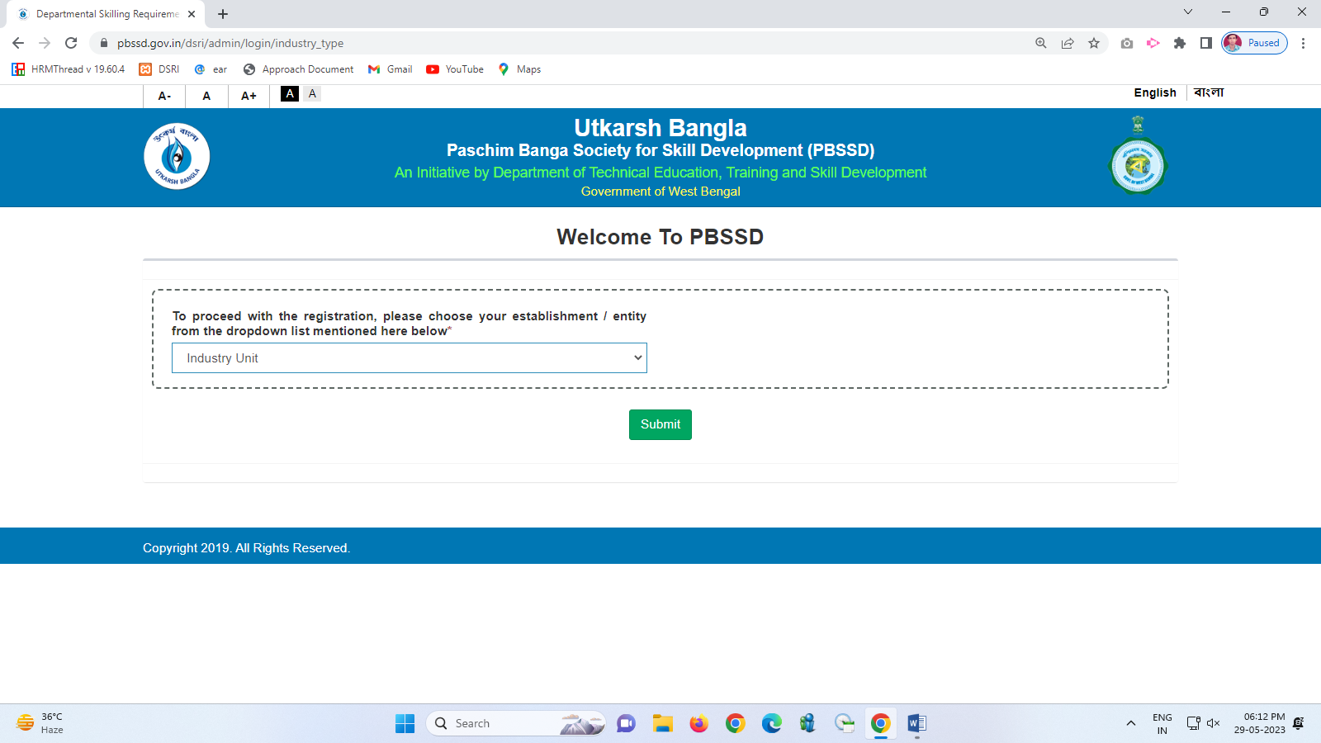
Click on “Submit” button.

Slide 7
Registration form

Slide 8
After fill-up the registration form, click on “Submit &Proceed For OTP Verification” button.

Slide 9
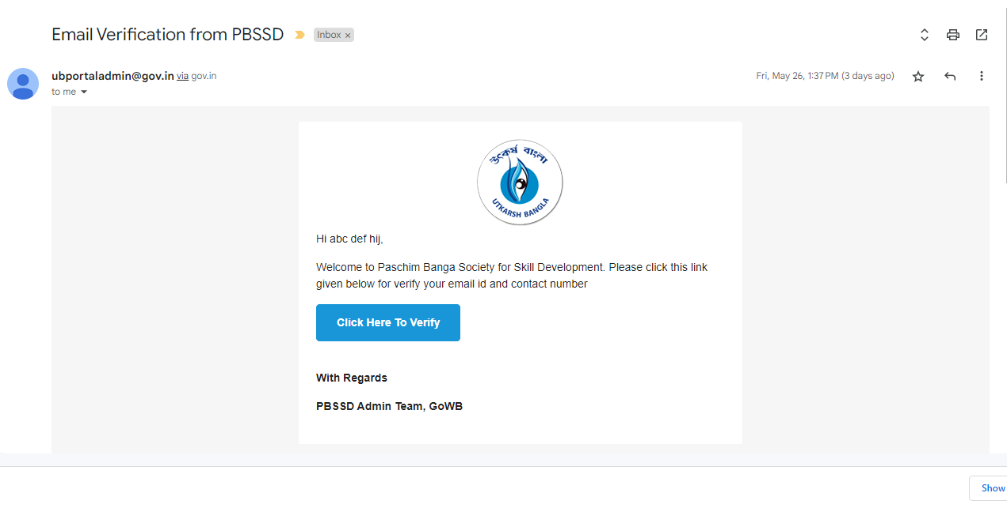
Entity will receive a verification mail in registered mail id, Please click on “Click Here To Verify” button.

Slide 10
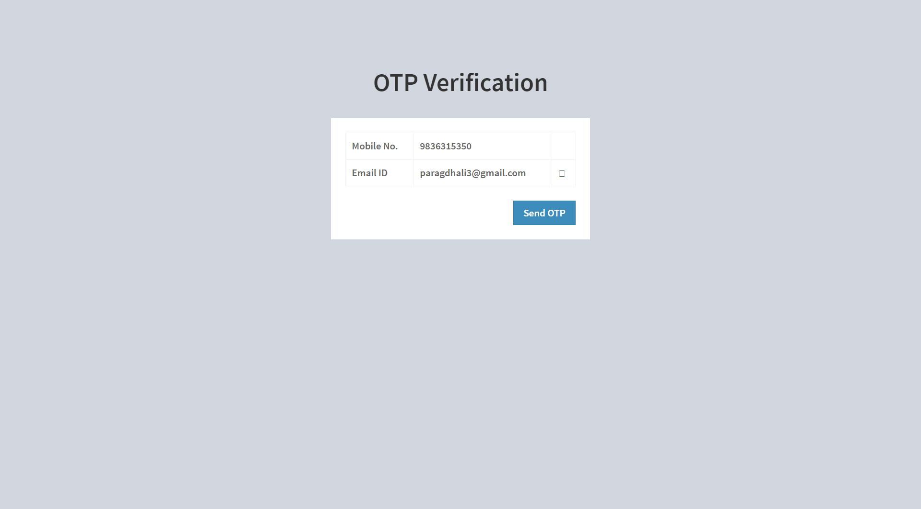
Click on “Send OTP” button. OTP will be received at registered mobile no.

Slide 11
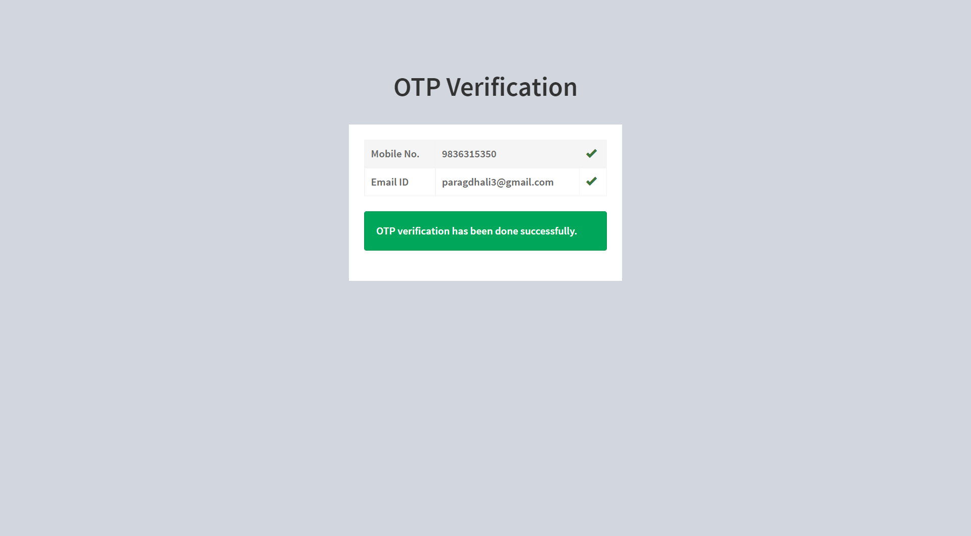
After verify the OTP success message will be shown.
Line Department will now verify the Entity details and approve accordingly.
After approval from Line Department, Entity will receive the login credentials at their registered mail id.

Slide 12
Demand Generation

Slide 13
Login page of all stakeholders for Departmental Skilling Requirement for Industries Module URL : https://www.pbssd.gov.in/dsri/admin/

Slide 14
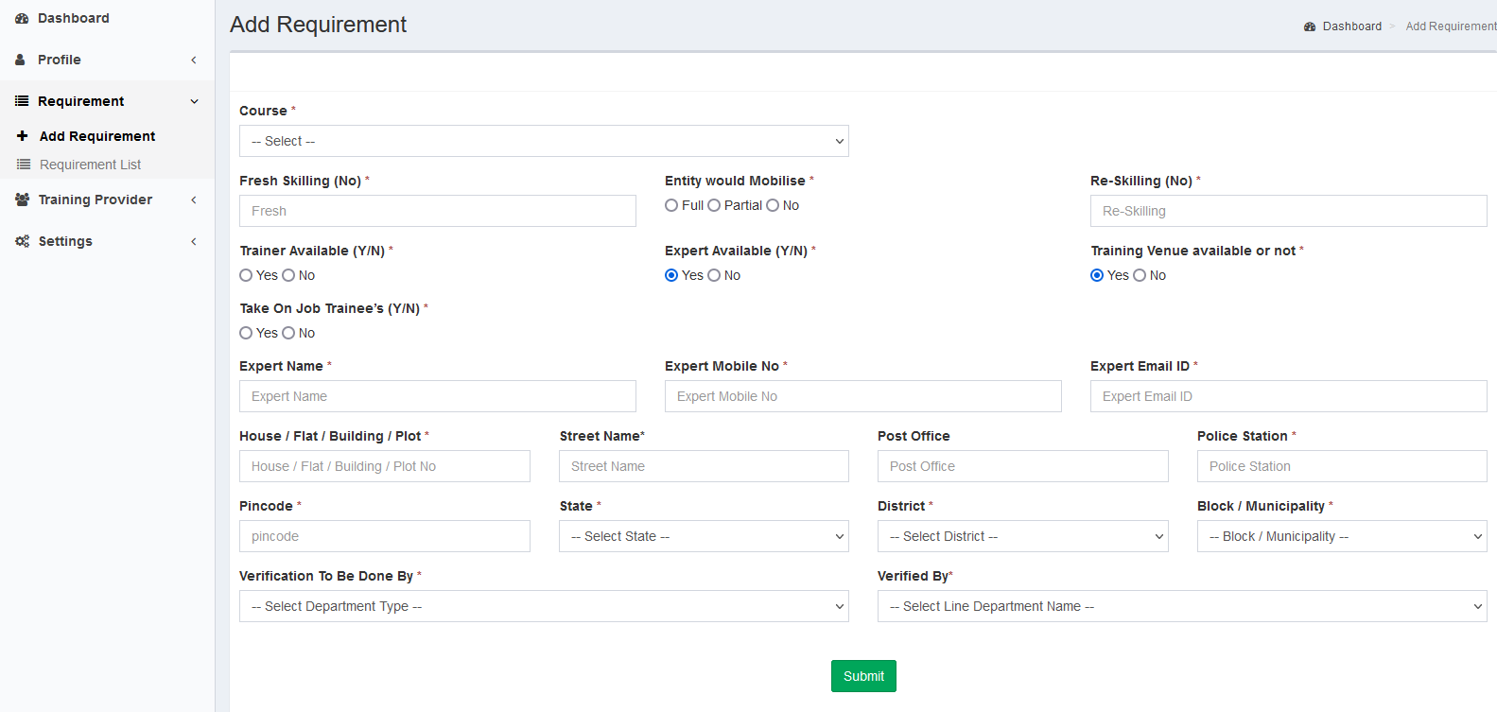
Industry / Entity can submit their own requirements job-role wise from their dashboard

Slide 15
Thank You

